Slide 1

Pretzo imc plan
Mira Ahmed Mohamed Ibrahim
Nadeem AlaaEldin Abdulfattah
Jenny Ehab
Haneen Hassan Mahmoud
Dina Khaled Hassan

Slide 2
Executive Summary
Information about product. What is Pretzo?
We use 100% natural ingredients. Our products are always baked not fried, which brings a combination of healthy and tasty pretzels with different flavors that are free of cholesterol, additives, and artificial coloring.
Problems or issues we are facing
The company has a weak product awareness due to lack of advertisements, so…
IMC role in solving those problems and issues

Slide 3
General background and history
At Kemet, we have been spearheading Pretzels and snacks since 1998
Kemet's portfolio takes into account each taste bud out there, with new flavor mixes across our product offerings in both neighborhood and abroad business sectors.
Kemet got the Halal and FDA approvals as well as quality certifications from ISO 22000:2005 and OHSAS 18001:2007

Slide 4
The market our product operates in
Pretzo operates in the food industry in broad terms
Also, it operates in the “Healthy snacks” section in Egypt and Africa in narrow terms

Slide 5
External Analysis
PEST analysis
Competitors analysis
Our opportunity resulting from PEST analysis
Direct Competitors:
The most distinguishable competitor is Abu Auf pretzels
Indirect Competitors:
Ex: Bake rolls, Chipsy, Pringles, Cheetos, …. etc

Slide 6
Competitors analysis (aBu auf)
Strengths and Weaknesses
Segments
Their strengths
A well-known brand
Unique products
Their pretzels have very high quality and very
good taste
Their weaknesses
- Packaging is so old fashioned
- Very few ads
- Product distribution
Geographic segmentation Ex: Heliopolis, Nasr city, Maadi, ELzamalek, ELshrouk, ELobur…. etc.
Demographic segmentation A class people
Benefits/needs segmentation very healthy and have high quality
Behavioral segmentation customers who buy Abu Auf products are very loyal to the brand
Psychographic segmentation Customers who have healthy lifestyle and care about their health
Socioeconomic relatively high income consumers

Slide 7
Consumer Analysis
Segments:
Geographic segmentation different places. ex: big hyper and supermarkets, as well as small and local (kiosks) ones
Socioeconomic middle class people as the product is so affordable
Psychographic segment People who have a healthy, sportive lifestyle, as well as vegan/vegetarian people
Benefits/needs
- Very healthy and nutritive, it isn’t fried but baked
- A light and low-fat snack
Our consumers make decisions by applying behavioral decision making process (low involvement)
Also it can be an emotional decision making

Slide 8
Consumer Analysis
Roles:
Influencer
It might be the eldest kid in the family who is following many celebrities and influencers
Gatekeeper
It might be the mother who cares about her family’s health
Purchaser/user
They are most likely the same person (could be all the members of the family).

Slide 9
SWOT
STRENGTHS
1) pretzo is an Egyptian product that has been produces since 1998 and can be trusted.
2) High quality product, low unit price.
3) A healthy snack as Pretzo is low calories, low fat [baked not fried], no artificial flavors, no added colors, presevative free and high in fiber.
4) We launched a new family size package to enjoy it with your beloved ones.
5) Can be used in food recipies.
6) Available at wellknown markets as carrefour.
7) Loyal customers, people who
tries it like it.
WAKNESSES
1) Adverising and promotional capabilities.
OPPURTUNITIES
1) Changes in lifestyle, increasing the number of healthy people consuming more healthy snacks since covid-19 virus.
2) The majority of people is buying products online according to the pandemic, pretzo is available in online markets as souq.com
2) The targeted segment is wide as pretzo can be consumed by any age starting from 3+ years old.
3) Lowest pretzels price among competitors
4) Pretzo is a healthy snack product which is rare in the markets.
5) Advertise to improve brand recognition.
THREATS
1) Not many people knows about the product.
2) The product can be replaced by another healthy snack.
3) Competitors spend far more on advertising.
4) Could be copied by competing natural products.

Slide 10
Marketing Objectives
Increase sales by 20% by the end of the year, achieving turnover of 2,500,000 EGP, profit of 750,000 EGP
Increases the market share by the end of the year by 40%
Increase availability by 60% by the end of the year
We are collaborating with the Egyptian Food Bank, so we are aiming to send them 10% of our sales

Slide 11
Analysis of Promotional Program Situation
In 2018 we have made an ad that was based on the UGC (user-generated content)
It was about asking people to share their stories with Pretzo by uploading photos they took of the product and mention @PretzoEgypt to win a polaroid camera or another delicious Pretzo

Slide 12
Our positioning strategies are
Attributes/benefits as we guarantee it is 100% natural and healthy
Product users we target all people but especially healthy and vegan people
Price/quality a very special price when it comes to its high quality (affordable to all)

Slide 13
the marketing mix decisions aligned with our positioning
Place Decisions
Direct or indirect channels: We are using the indirect channels which are retailors as Saudi Market and Alfa Market. Also, we sell online on websites such as souq
Intensity of distribution: Pretzo is using the intensive distribution strategy to achieve the highest market coverage

Slide 14
communications state
Sources who are proposed to be used: We would use models as our source but we won’t show their faces
Why?
Because we want pretzo to be the main focus of the ad. Also, we want to avoid using celebrities to not overshadow our product.

Slide 15
communications channels
We are using TV ads, Internet (Facebook, Instagram, YouTube), Billboards, which we will discuss later in more details

Slide 16
Response model
As our product is a low involvement and a low differentiated product so as a result of this, we must use Repetition

Slide 17
SMART Communications Objectives
Increase product awareness among all our target audience by 70% by the end of the year How? By the repetition
Increase interest for the product by 50% among our target audience by the end of the year How? Communicating in the ads that pretzo is healthy and suitable for all ages
Develop positive feelings about our product by 30% by the end of the year How? communicating with our target audience that we are collaborating with The Egyptian Food Bank

Slide 18
the advertising budget
As we have weak product awareness, we are using bottom-up budgeting
TV ads = EGP 650,000
Billboards = EGP 160,000
YouTube = EGP 95,000
Sponsoring on social media = EGP 95,000
Total Budget = EGP 1,000,000

Slide 19
Push/Pull Promotional Strategy
We are using Pull promotional strategy in our ads as want to increase our brand awareness and attract our end consumers
We want them to know more about what our product offers and who we are collaborating with

Slide 20
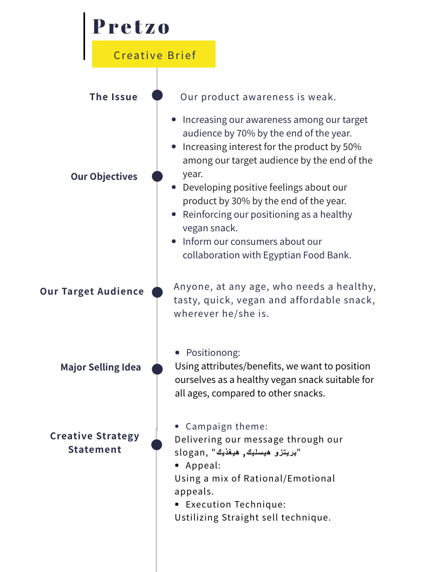
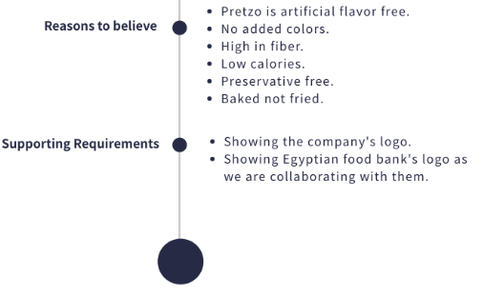

Slide 21
Promotional Mix
Advertising To reach mass audience and to deliver the message to our target audience, we will use different TV Channels to show our TV ad, as well as billboard ads
Public Relations We will use CSR Activities as we are collaborating with Egypt Food Bank to develop positive image
Digital Marketing internet: to share our campaigns on our social media accounts, Facebook and Instagram for a direct response and feedback
Also, we are using video ads (YouTube) to share our ad

Slide 22
Media plan
Media Objectives
Coverage we are aiming to provide coverage of 85% in the first six months
Reach increase our reach by 55%, at least 12 times each month for each person during the first six months
Frequency at least three times a week in the first six months

Slide 23
Media plan
Media Strategy
As our product category needs repetition of ads, we are using a continuous pattern of advertising (Continuity)
Medium | Media Vehicle
Broadcast (TV channels) | MBC masr, MBC masr 2, ON TV, PNC Food
OOH | Billboards
Internet (video ads, social media) | YouTube ads, Facebook, Instagram

Slide 24
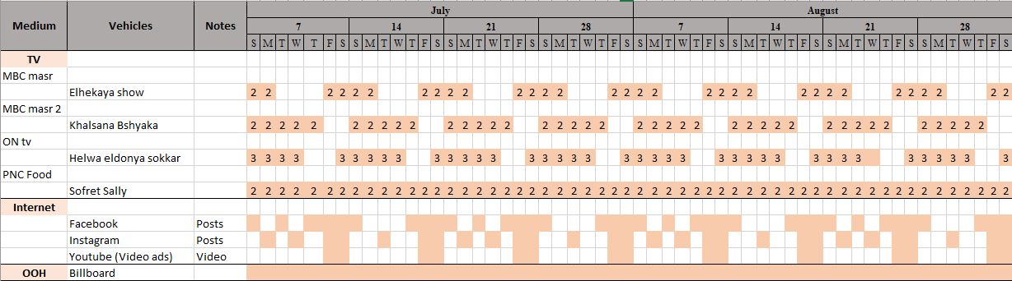
Media schedule

Slide 25
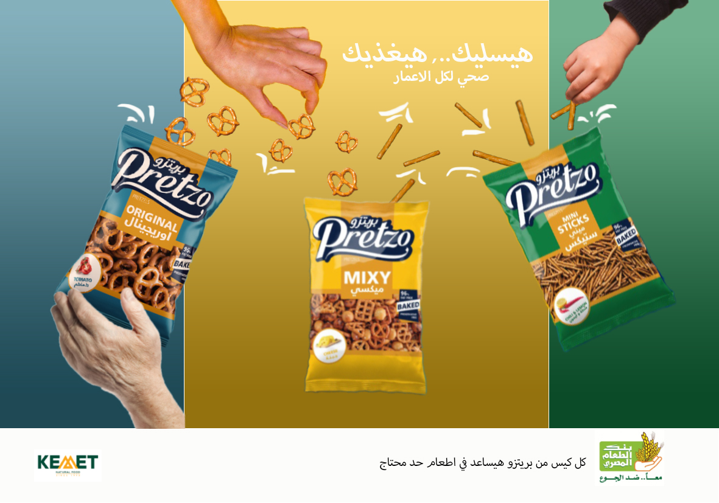
Billboard

Slide 26
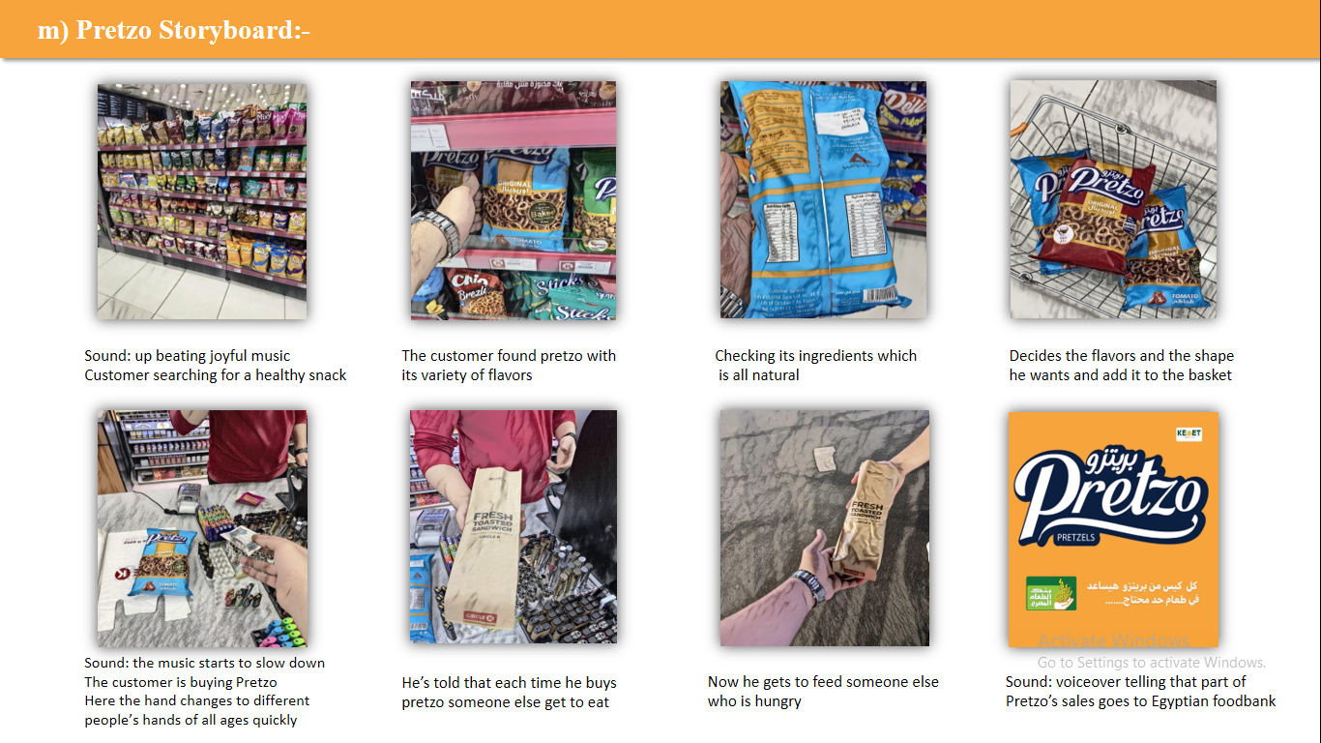

Slide 27
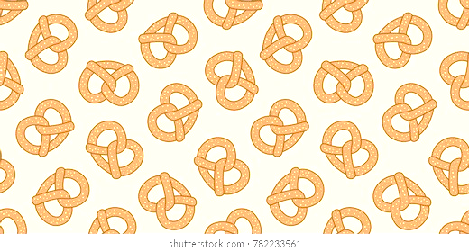
Any Comments or questions?

Slide 28
THANK YOU!

